Slide 1
Manager Role

Slide 2
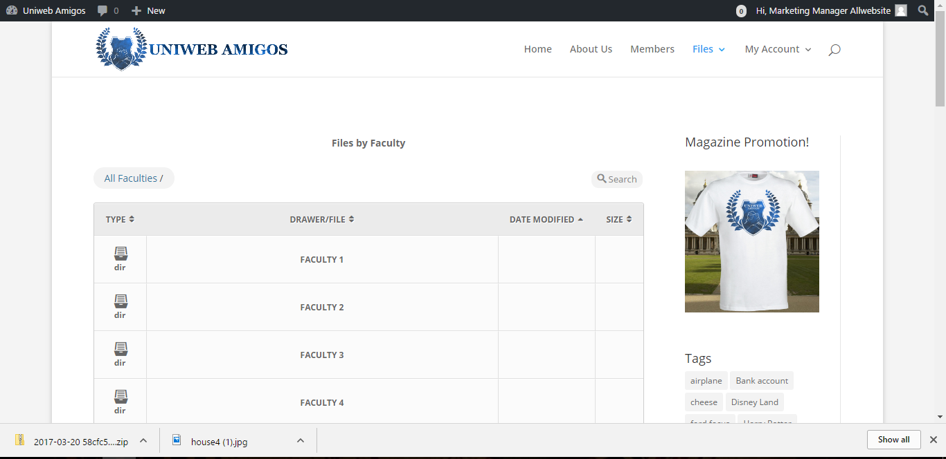
Marketing Manager Dashboard
Four of the faculties showing:
Uploaded files
Uploaded Image
Options for downloading
Magazine promotion

Slide 3
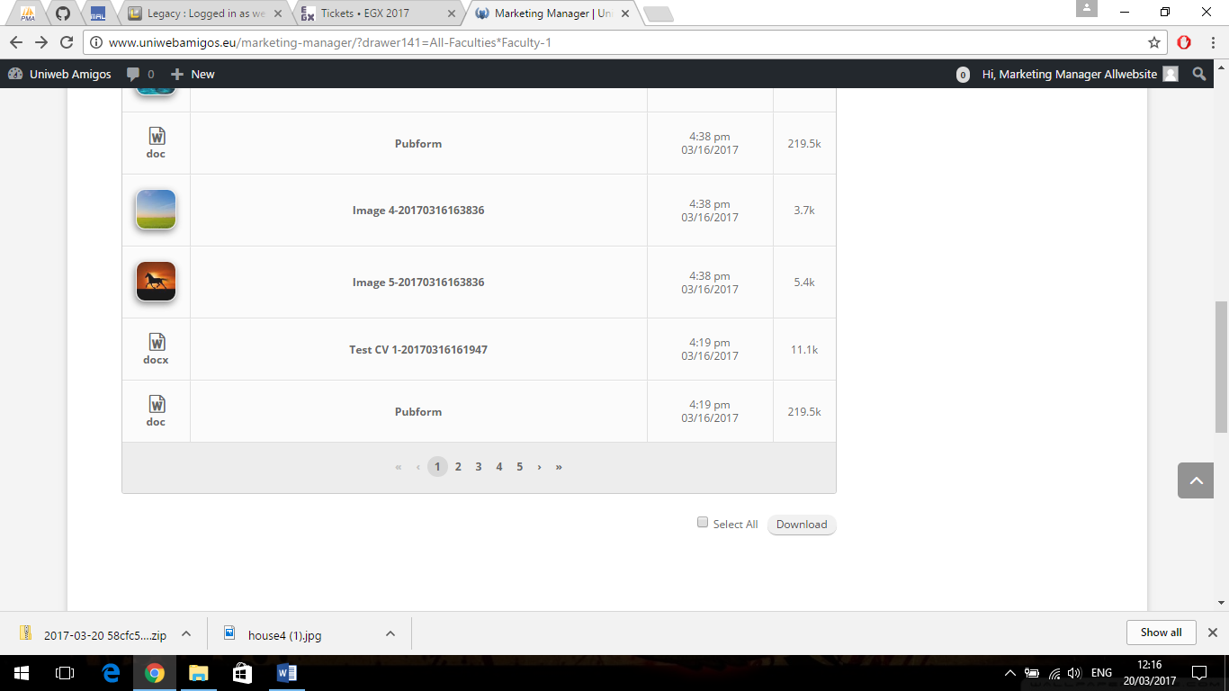
Marketing Manager Bottom Dashboard
Allows you to view the recently uploaded files and download either separately or all in a zipped folder

Slide 4
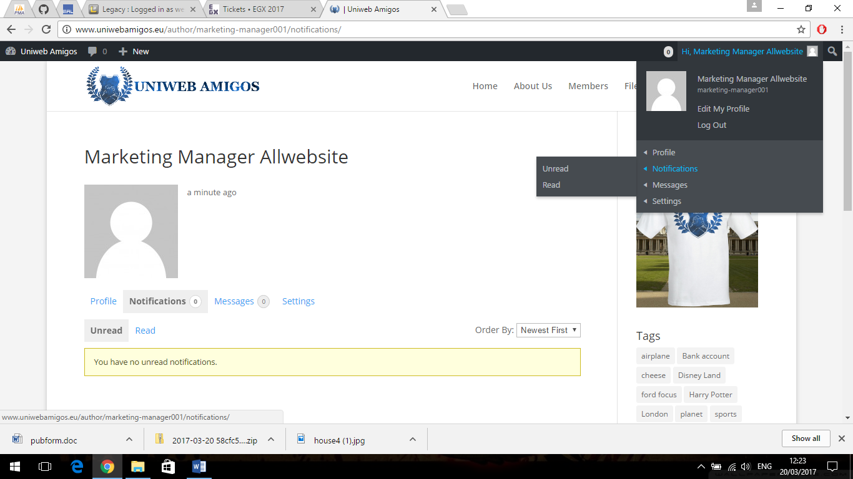
Marketing Manager Profile
Allowing to view notifications and messages that have been received and edit profile and log out

Slide 5
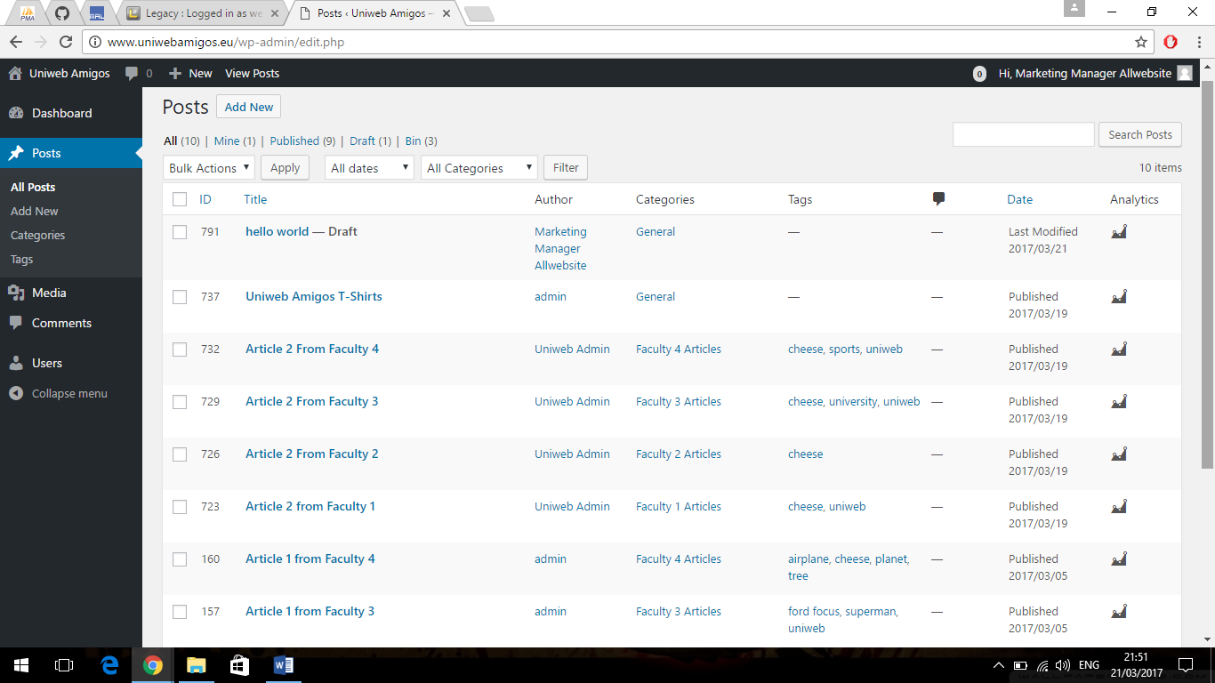
Marketing Manager Posts
This page will be to see all the articles that are seen on the homepage and the marketing manager has to be the final say to publish it

Slide 6
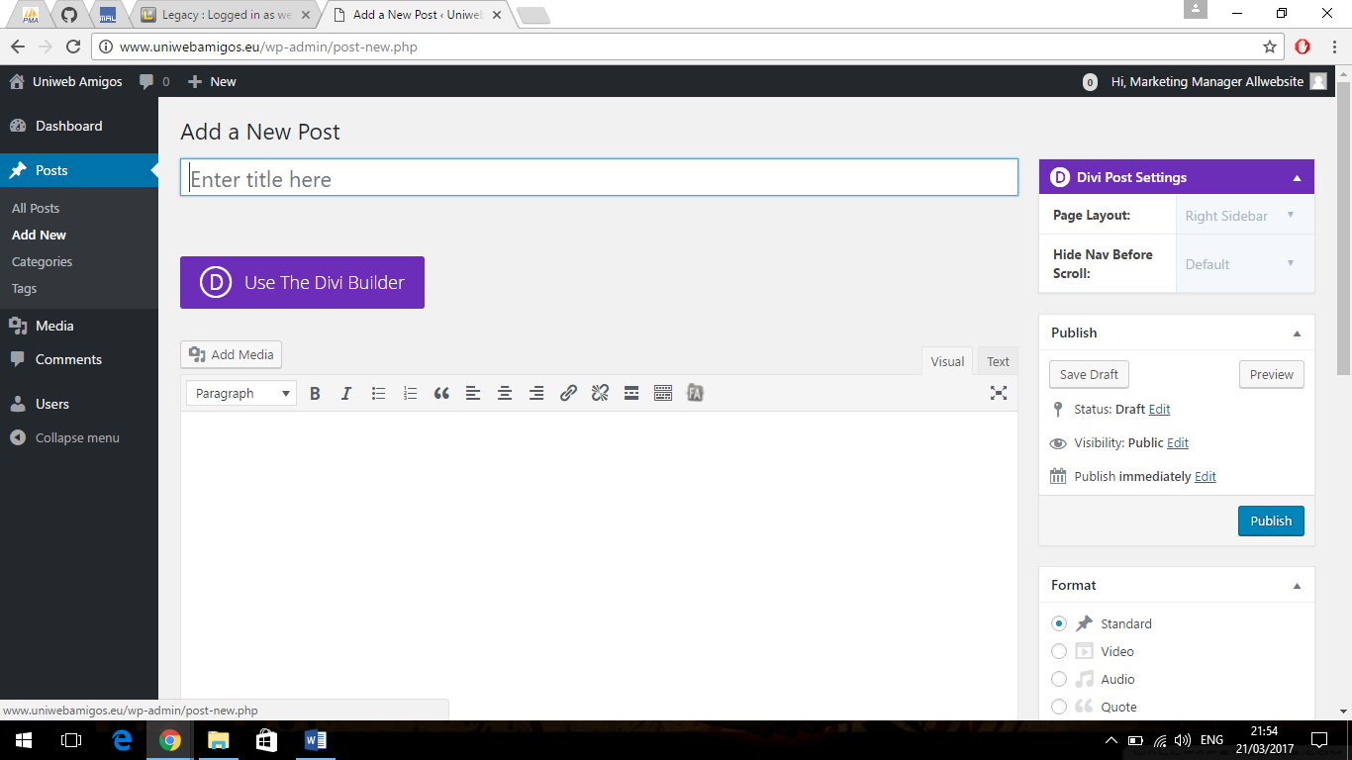
Making A New Post To Publish
This Page Allows you to publish to the magazines home screen for any of the students files that have been uploaded.

Slide 7
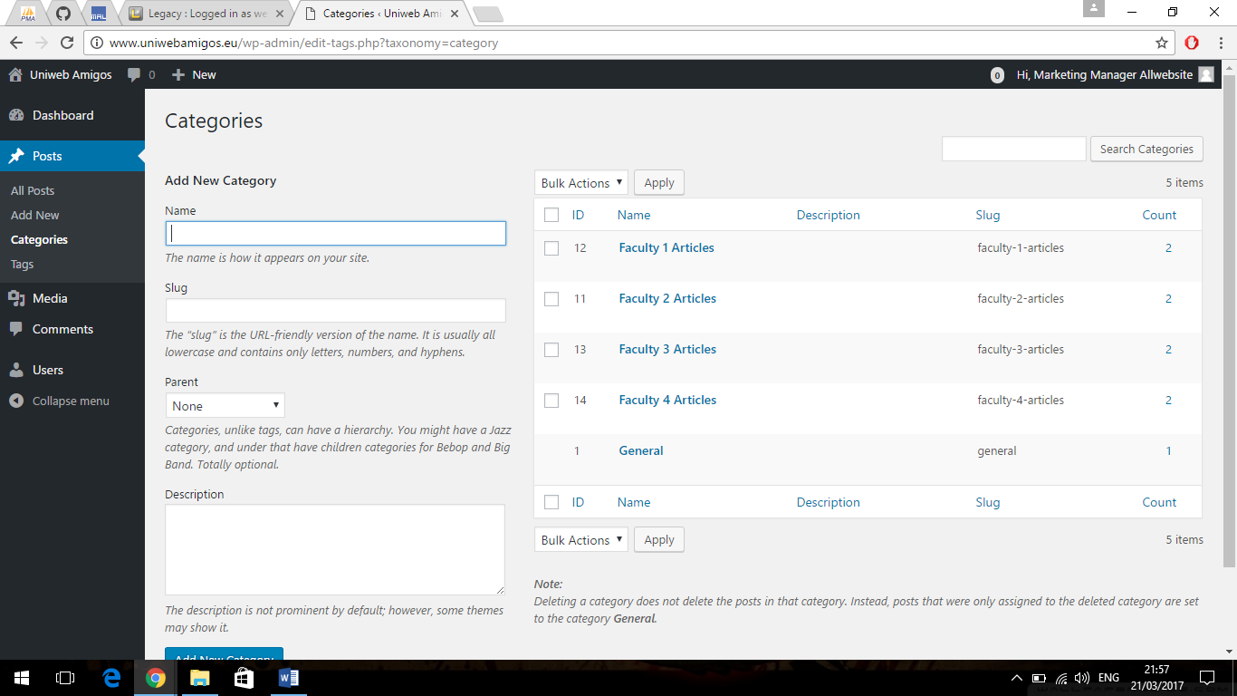
Marketing Manager Categories
This page the manager can more categories to the site for example another faculty

Slide 8
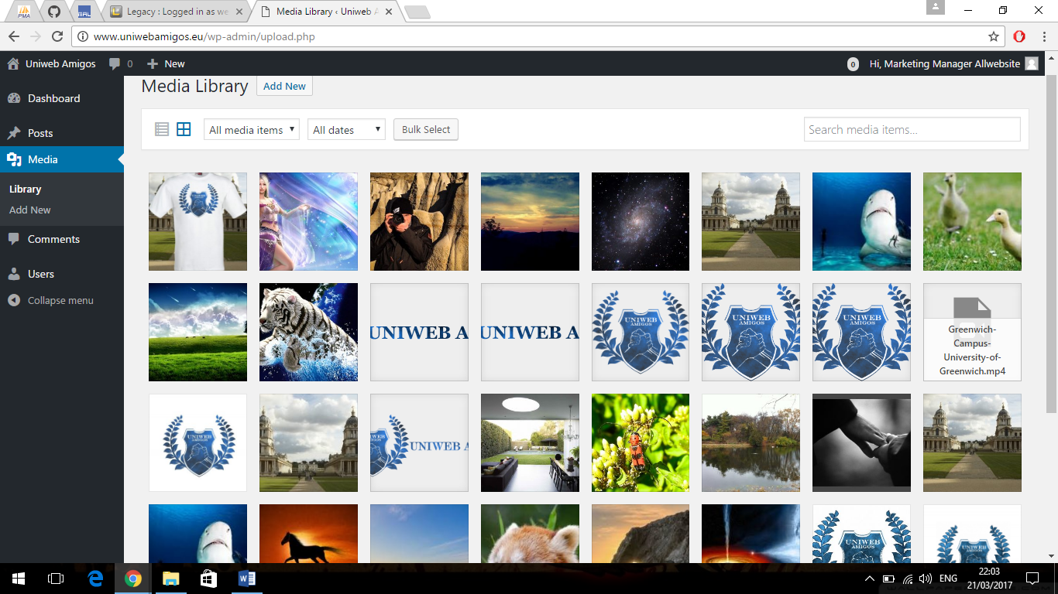
Marketing Manager Media Library
Allows you to manage the media library by removing and adding.

Slide 9
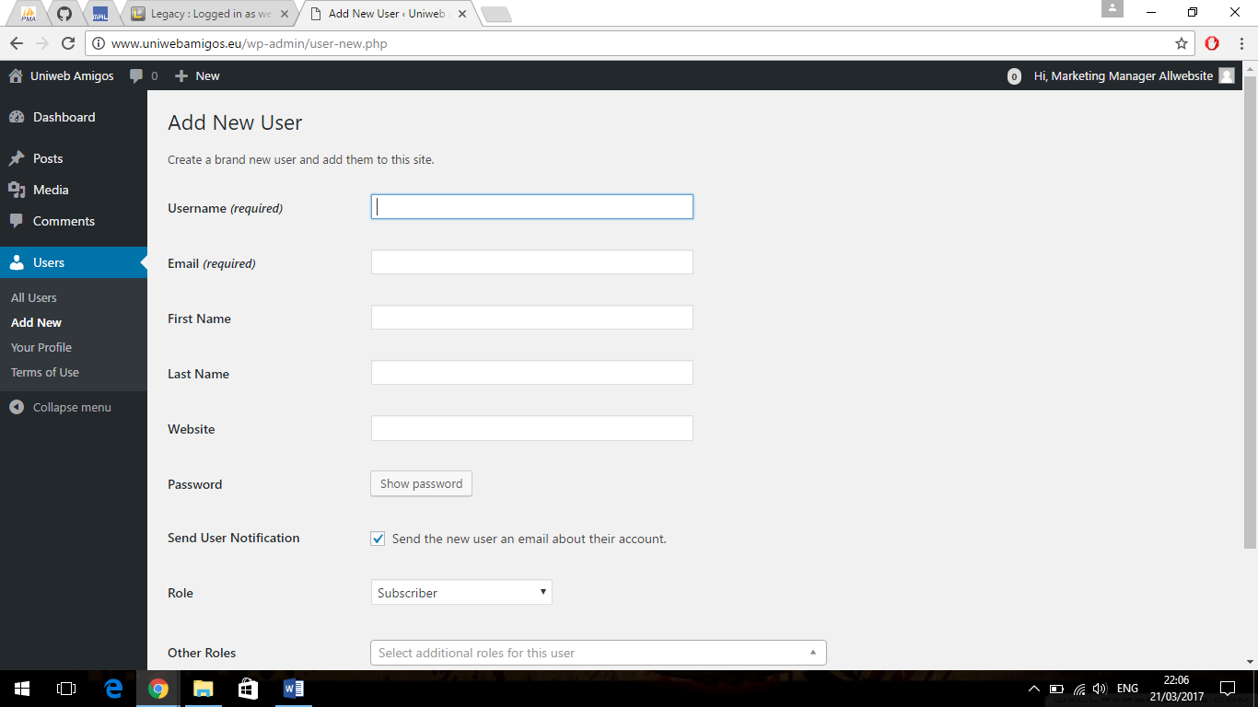
Marketing Manager Adding Users
This is the marketing managers add user page that allows them to add users to the site

Slide 10
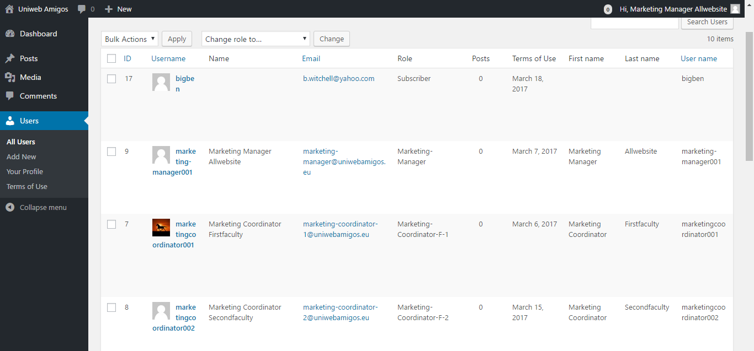
Marketing Manager Users
This Page allows the manager to view the users and edit the user accounts

